Slide 1


Lecture 12:
Midterm Evaluation & Object-Oriented Programming
CoTaPP: Computational Thinking and
Programming with Python
All icons by: https://www.flaticon.com/

Slide 2


Midterm Evaluation

Slide 3
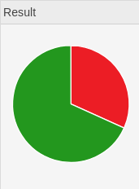
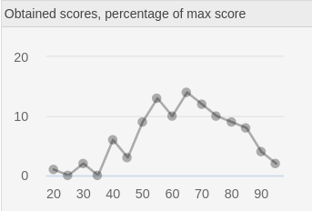
Midterm Evaluation
68%
≥5.5

Slide 4
Midterm Evaluation
68%
≥5.5
Grades will be posted on Thursday morning

Slide 5
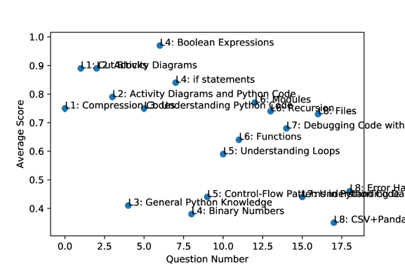
Midterm Evaluation

Slide 6
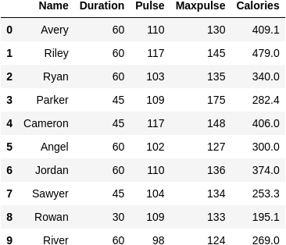
Midterm Evaluation
df.loc[2,"Maxpulse"]
df.loc[2]["Maxpulse"]
df.iloc[2]["Maxpulse"]
df.iloc[2,3]
The maxpulse of the workout from Ryan

Slide 7
Midterm Evaluation
df.loc[2,"Maxpulse"]
df.loc[2]["Maxpulse"]
df.iloc[2]["Maxpulse"]
df.iloc[2,3]
df[df["name="Ryan",column="maxpulse"]
The maxpulse of the workout from Ryan

Slide 8
Midterm Evaluation
df.loc[2,"Maxpulse"]
df.loc[2]["Maxpulse"]
df.iloc[2]["Maxpulse"]
df.iloc[2,3]
df[df["name="Ryan",column="maxpulse"]
The maxpulse of the workout from Ryan

Slide 9
Midterm Evaluation
df.loc[2,"Maxpulse"]
df.loc[2]["Maxpulse"]
df.iloc[2]["Maxpulse"]
df.iloc[2,3]
df[df["name="Ryan",column="maxpulse"]
df[df[¨Maxpulse¨]==¨Ryan¨]
The maxpulse of the workout from Ryan

Slide 10
Midterm Evaluation
df.loc[2,"Maxpulse"]
df.loc[2]["Maxpulse"]
df.iloc[2]["Maxpulse"]
df.iloc[2,3]
df[df["name="Ryan",column="maxpulse"]
df[df[¨Maxpulse¨]==¨Ryan¨]
The maxpulse of the workout from Ryan

Slide 11
Midterm Evaluation
df.loc[2,"Maxpulse"]
df.loc[2]["Maxpulse"]
df.iloc[2]["Maxpulse"]
df.iloc[2,3]
df[df["name="Ryan",column="maxpulse"]
df[df[¨Maxpulse¨]==¨Ryan¨]
df.iloc[2:3,3:4]
The maxpulse of the workout from Ryan

Slide 12
Midterm Evaluation
df.loc[2,"Maxpulse"]
df.loc[2]["Maxpulse"]
df.iloc[2]["Maxpulse"]
df.iloc[2,3]
df[df["name="Ryan",column="maxpulse"]
df[df[¨Maxpulse¨]==¨Ryan¨]
df.iloc[2:3,3:4]
The maxpulse of the workout from Ryan
DataFrame!

Slide 13
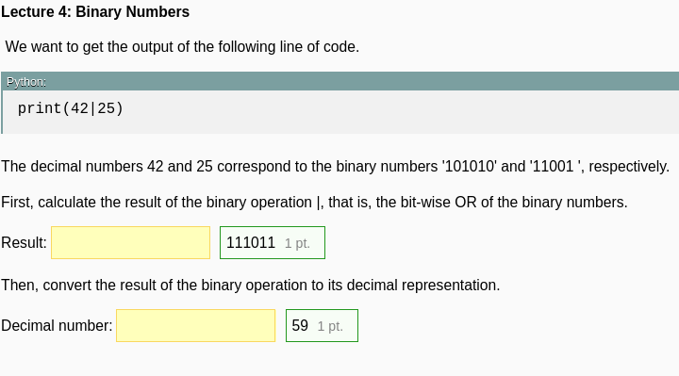
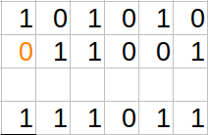
Midterm Evaluation

Slide 14
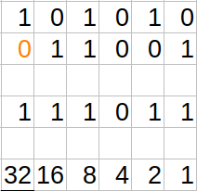
Midterm Evaluation

Slide 15
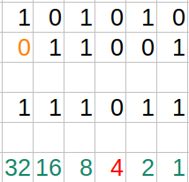
Midterm Evaluation

Slide 16
Midterm Evaluation
32 + 16 + 8 + 2 + 1 = 59

Slide 17
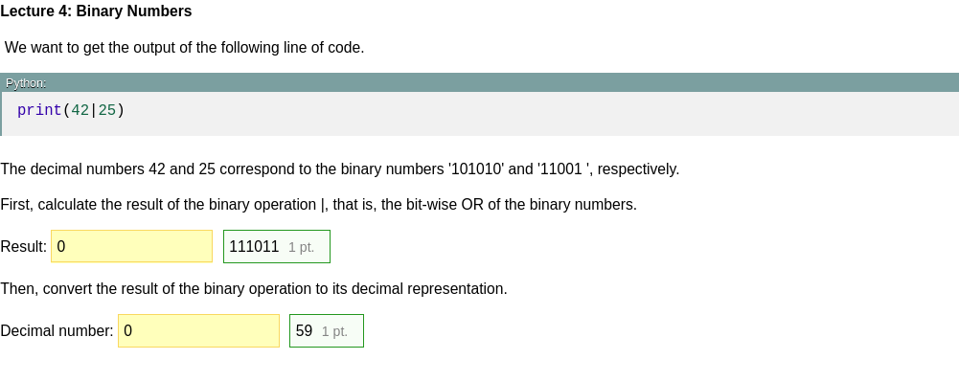
Midterm Evaluation

Slide 18

Midterm Evaluation

Slide 19

Midterm Evaluation

Slide 20
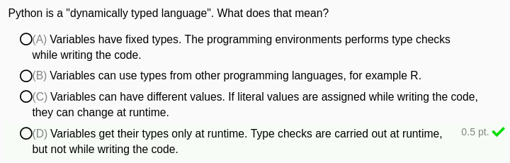
Midterm Evaluation

Slide 21
Midterm Evaluation

Slide 22
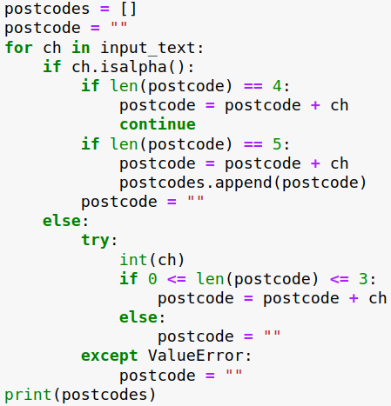
Previous Lecture
(([\w-]+(?:\.[\w-]+)*)@((?:[\w-]+\.)*\w[\w-]{0,66})\.([a-z]{2,6}(?:\.[a-z]{2})?))(?![^<]*>)
Patient: Mary Johnson
Address: Merelstraat 32, 4005 EX Tiel
Mrs has slept badly, slept from
1:00 until 4:00. Came then from
bed, ate cookies and drank tea.
Still advised to take medication
and voiced my concern about
evt. conversion in mania. Mrs
was not happy about it and
reacted agitated.

Slide 23
Today
data
data
function
function
data
data
function
function
data
function
data
function

Slide 24
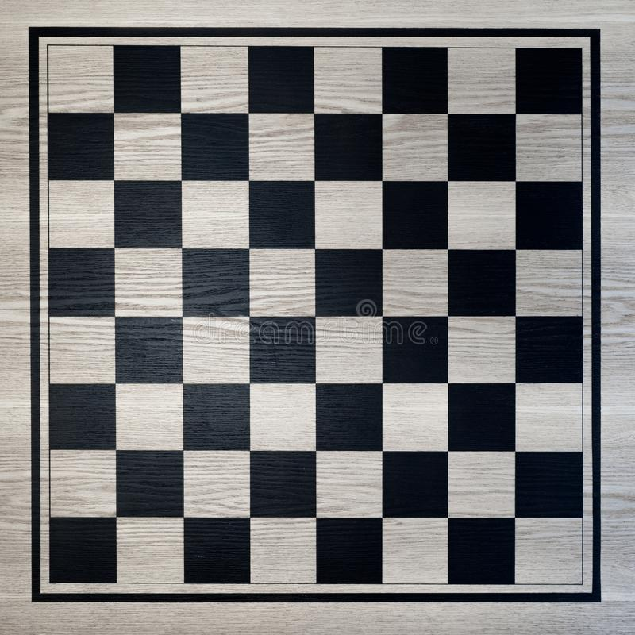
Case Study: Chess

Slide 25

Case Study: Chess

Slide 26
Case Study: Chess
Position

Slide 27
Case Study: Chess
Position
Colour

Slide 28
Case Study: Chess
Position
Colour
Captured (True/False)

Slide 29
Case Study: Chess
Position
Colour
Captured (True/False)
0
1
2
3
4
5
6
7
0 1 2 3 4 5 6 7

Slide 30
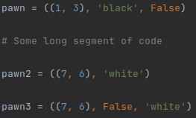
Problem 1: Creation error
Position
Colour
Captured (True/False)
0
1
2
3
4
5
6
7
0 1 2 3 4 5 6 7

Slide 31
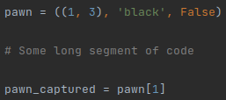
Problem 2: Retrieval error
Position
Colour
Captured (True/False)
0
1
2
3
4
5
6
7
0 1 2 3 4 5 6 7

Slide 32
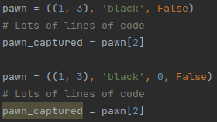
Problem 3: Rewriting
Position
Colour
Number of moves so far
Captured (True/False)
0
1
2
3
4
5
6
7
0 1 2 3 4 5 6 7

Slide 33
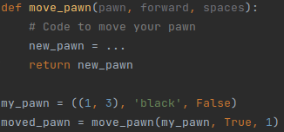
Problem 4: Passing data around
Position
Colour
Captured (True/False)
0
1
2
3
4
5
6
7
0 1 2 3 4 5 6 7

Slide 34
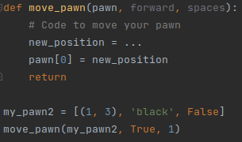
Problem 4: Passing data around
Position
Colour
Captured (True/False)
0
1
2
3
4
5
6
7
0 1 2 3 4 5 6 7

Slide 35

Problem 5: Functions for types
Position
Colour
Captured (True/False)
0
1
2
3
4
5
6
7
0 1 2 3 4 5 6 7

Slide 36
Problem 5: Functions for types
Position
Colour
Captured (True/False)
0
1
2
3
4
5
6
7
0 1 2 3 4 5 6 7

Slide 37
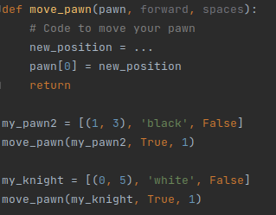
Problem 5: Functions for types
Position
Colour
Captured (True/False)
0
1
2
3
4
5
6
7
0 1 2 3 4 5 6 7

Slide 38
Problem 5: Functions for types
Position
Colour
Captured (True/False)
0
1
2
3
4
5
6
7
0 1 2 3 4 5 6 7

Slide 39
Solution: OOP
CLASS: template (any pawn)

Slide 40
Solution: OOP
CLASS: template (any pawn)
OBJECT: instance (a given pawn)

Slide 41
Solution: OOP
CLASS: template (any pawn)
OBJECT: instance (a given pawn)
FIELD: data (position, etc)

Slide 42
Solution: OOP
CLASS: template (any pawn)
OBJECT: instance (a given pawn)
FIELD: data (position, etc)
METHOD: class-specific function (e.g., move)

Slide 43
Solution: OOP
CLASS: template (any pawn)
OBJECT: instance (a given pawn)
FIELD: data (position, etc)
METHOD: class-specific function (e.g., move)
ATTRIBUTES

Slide 44
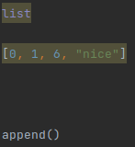
Lists
CLASS: template
OBJECT: instance
FIELD: data
METHOD: class-specific function

Slide 45
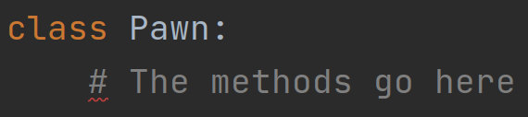
Pawn class

Slide 46
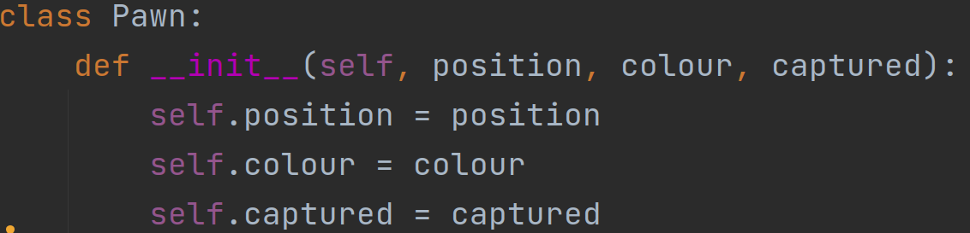
Pawn class

Slide 47
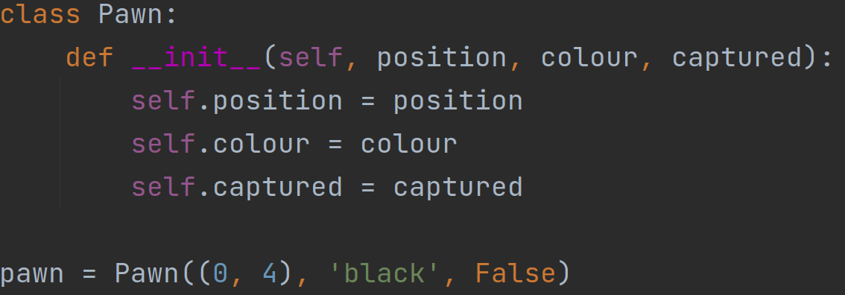
Pawn class

Slide 48
Pawn class
Methods
State
position
colour
captured

Slide 49
Pawn class
Class
Object
Methods
Methods
State
State
position
(0,4)
colour
‘black’
captured
False

Slide 50
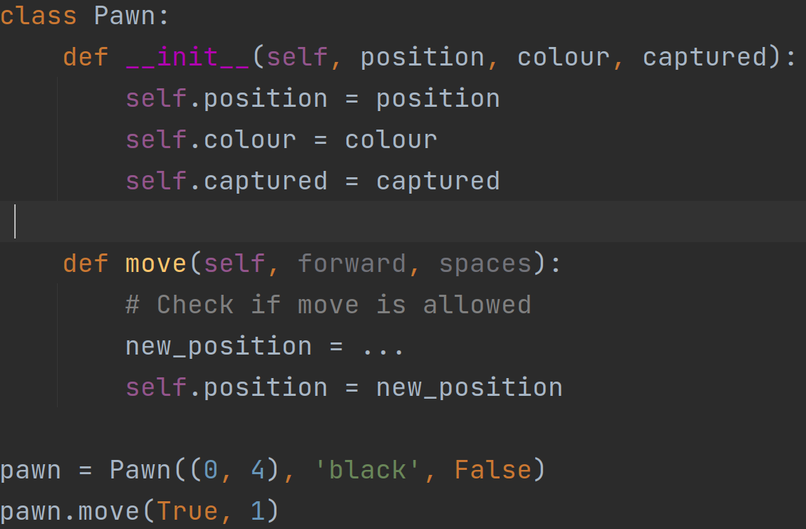
Pawn class

Slide 51
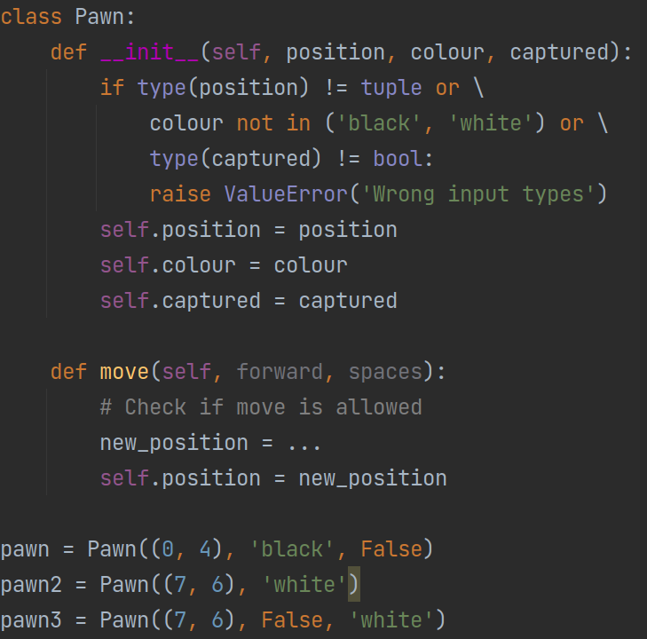
Problem 1: Creation error
Position
Colour
Captured (True/False)

Slide 52
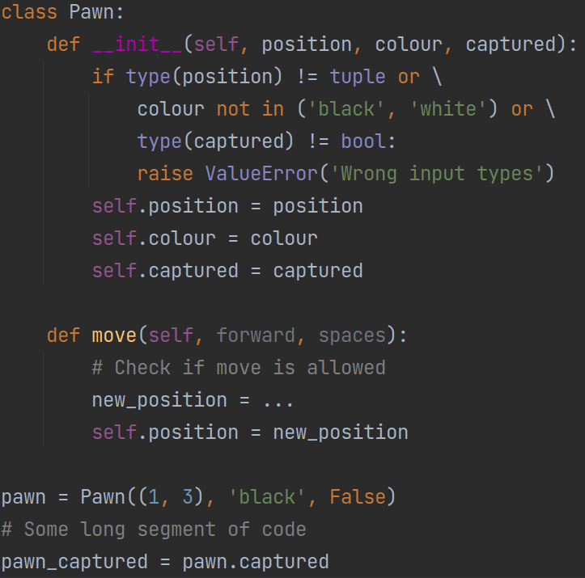
Problem 2: Retrieval error
Position
Colour
Captured (True/False)

Slide 53
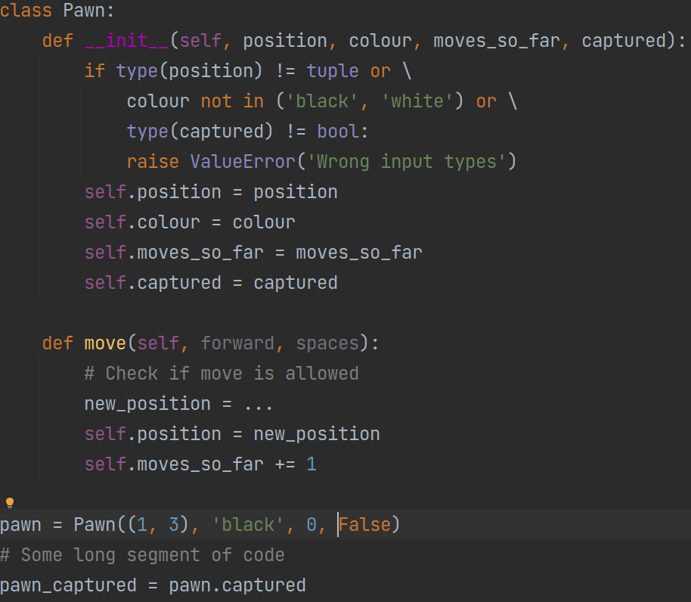
Problem 3: Rewriting

Slide 54
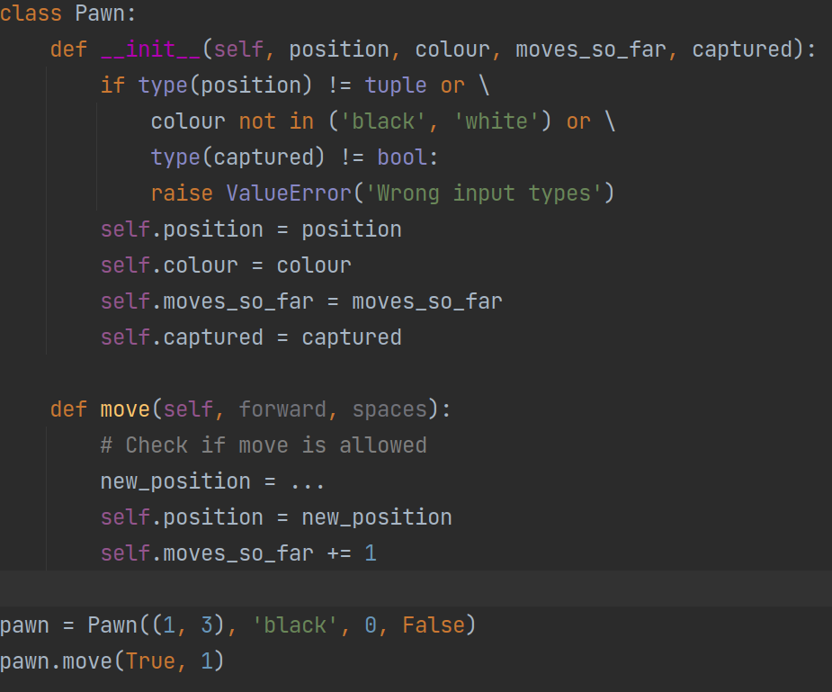
Problem 4: Passing data around
Position
Colour
Captured (True/False)

Slide 55
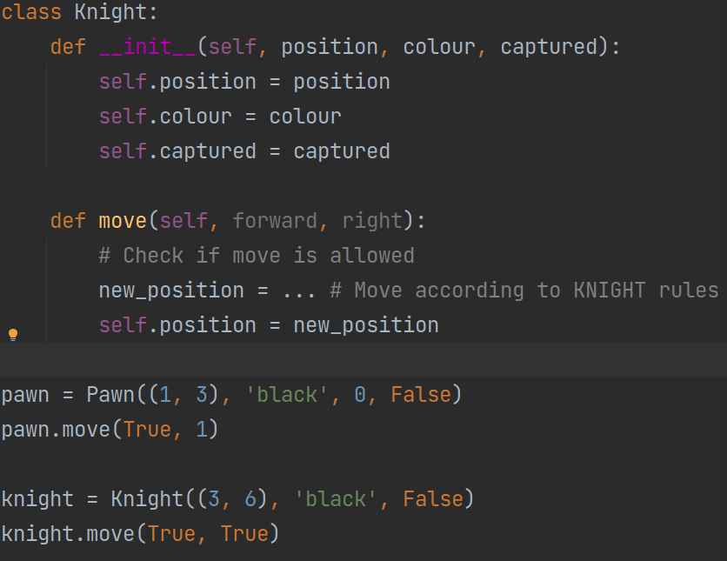
Problem 5: Functions for types
Position
Colour
Captured (True/False)

Slide 56
UML Class Diagrams
Knight
Pawn
position
colour
captured
position
colour
captured
move()
move()

Slide 57
UML Class Diagrams
Name
Knight
Pawn
Fields
position
colour
captured
position
colour
captured
Methods
move()
move()

Slide 58
Inheritance
ChessPiece
position
colour
captured
Knight
Pawn
move()
move()

Slide 59
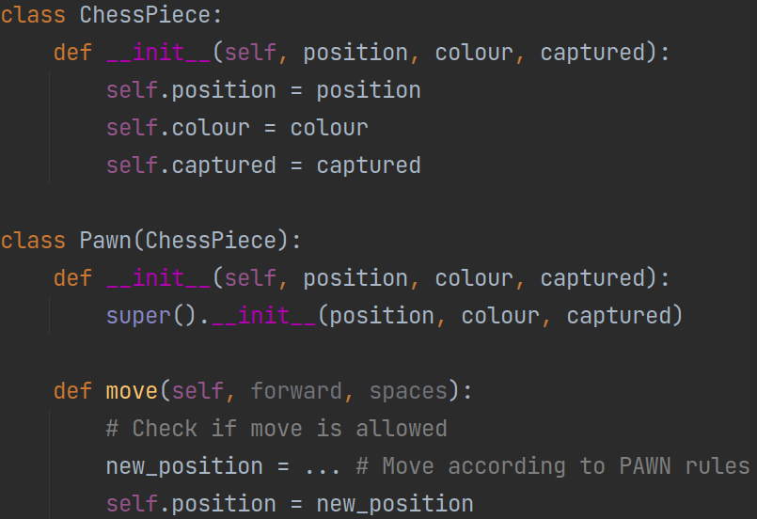
Inheritance

Slide 60
Higher-Order Functions
abs(7) → 7
abs(-7) → 7

Slide 61
Higher-Order Functions
abs(7) → 7
abs(-7) → 7
scores = [7, 5, 8, 4, 2, 10]
mean_score = 6.0
score_diff = [1.0, -1.0, 2.0, -2.0, -4.0, 4.0]

Slide 62

Higher-Order Functions
abs(7) → 7
abs(-7) → 7
scores = [7, 5, 8, 4, 2, 10]
mean_score = 6.0
score_diff = [1.0, -1.0, 2.0, -2.0, -4.0, 4.0]
abs_score_diff = map(abs, score_diff)
Function
Function

Slide 63
Higher-Order Functions
abs(7) → 7
abs(-7) → 7
scores = [7, 5, 8, 4, 2, 10]
mean_score = 6.0
score_diff = [1.0, -1.0, 2.0, -2.0, -4.0, 4.0]
abs_score_diff = map(abs, score_diff)
abs_score_diff = map(abs / 2, score_diff)
Function
Function

Slide 64
Higher-Order Functions
abs(7) → 7
abs(-7) → 7
scores = [7, 5, 8, 4, 2, 10]
mean_score = 6.0
score_diff = [1.0, -1.0, 2.0, -2.0, -4.0, 4.0]
abs_score_diff = map(abs, score_diff)
abs_score_diff = map(abs / 2, score_diff)
Function
Function

Slide 65
Higher-Order Functions
abs(7) → 7
abs(-7) → 7
scores = [7, 5, 8, 4, 2, 10]
mean_score = 6.0
score_diff = [1.0, -1.0, 2.0, -2.0, -4.0, 4.0]
abs_score_diff = map(abs, score_diff)
abs_score_diff = map(lambda x: abs(x) / 2, score_diff)
Function
Function

Slide 66


Slide 67
To Do
Exercises for the week
  Use Quarterfall to submit them
Continue with Project 3 classmates
Practice practice practice!
Ask questions!

